Slide 1

Functions, Objects and Classes
f(x)
SoftUni Team
Technical Trainers
Software University
http://softuni.bg

Slide 2

Table of Contents
Functions
Return statement, Procedures, Arguments, Type hinting, Variables scope
Classes and Objects in OOP
OOP in PHP
Define Simple Classes
Creating Classes and Objects
Using Namespaces
Include and Require

Slide 3
Have a Question?
sli.do
#php-web

Slide 4

PHP Functions

Slide 5
Functions in PHP
In PHP we have two type of functions:
User-defined Function
Built-in Function
User-defined Function: is the function created by user
Built-in Function: is the function created by PHP, and ready to use

Slide 6
Why Use Functions?
More manageable programming
Splits large problems into small pieces
Better organization of the program
Improves code readability
Improves code understandability
Avoiding repeating code
Improves code maintainability
Code reusability
Using existing functions several times

Slide 7
{…}
Declaring and Invoking Functions
Notes:
Add Image!

Slide 8
Declaring Function
Functions are named blocks of code
Declared with the keyword function
Can accept parameters and return value
Help organize and reuse the code
Function Name
Parameters
function rectangleArea($sideA, $sideB) {
return $sideA * $sideB;
}
echo rectangleArea(5, 6);
Function Body
Function Invocation

Slide 9
$
Parameters
Void and Return type Functions

Slide 10
Parameters
To pass an information to a function, you can use parameters(arguments)
Arguments are specified after the function name, inside the parentheses
You can have zero or several arguments
Each parameter has a name
You can set default value
Parameters change the behavior of a function

Slide 11
Void and Return type Functions
Function Without Parameters
Function With Parameters
Void
function
function sumNumbers() { $result = 20 + 15;
echo $result;
}
sumNumbers();
Parameter
function sumNumbers($num) { $result = 20 + $num;
return $result;
}
Return type function
echo sumNumbers(10);

Slide 12
Returning Multiple Values from a Function
You can use fixed-size arrays to return multiple values
The list keyword assigns multiple variables from array items
list is NOT a function, but a language construct
Works only for numerical arrays and assumes indexes start at 0
function smallNumbers() {
return [0, 1, 2];
}
list($a, $b, $c) = smallNumbers();
echo "\$a = $a; \$b = $b; \$c = $c";

Slide 13
Default Parameter Values
Function with default value of parameters
function sumNumbers($num1 = 6, $num2 = 4) { $result = $num1 + $num2;
return $result;
}
echo sumNumbers(); //10
echo sumNumbers(10, 20); //30
echo sumNumbers(null, null); //0

Slide 14
Functions Parameters: Pass by Reference
By default PHP passes arguments to functions by value
Changed arguments in the function will be lost after it ends
To force pass by reference use the & prefix
function changeValue(&$arg) {
$arg += 100;
}
$num = 2;
echo $num . "\n"; // 2
changeValue($num);
echo $num; // 102

Slide 15
Variable Number of Arguments
PHP supports variable-length function arguments
Read the arguments: func_num_args() and func_get_args()
function calcSum() {
$sum = 0;
foreach (func_get_args() as $arg) {
$sum += $arg;
}
return $sum;
}
echo calcSum(1, 2); // 3
echo calcSum(10, 20, 30); // 60
echo calcSum(10, 22, 0.5, 0.75, 12.50); // 45.75

Slide 16
Variable Number of Arguments (2)
PHP 5.6+ may include the ... token
Read the arguments: …$params
function calcSum(...$params) {
$sum = 0;
foreach ($params as $arg) {
$sum += $arg;
}
return $sum;
}
echo calcSum(1, 2); // 3
echo calcSum(10, 20, 30); // 60
echo calcSum(10, 22, 0.5, 0.75, 12.50); // 45.75

Slide 17
Type Hinting/Declaration
In later version of PHP you can hint the expected type of
the arguments
In PHP 7+ You can also hint the return type of the function
By default, PHP will coerce values of the wrong type into the expected
scalar type if possible.
It is possible to enable strict mode on a per-file basis.
declare(strict_types = 1); // Strict mode
function example(int $arg): int {
// The returned result should be int
return $arg + 1;
}

Slide 18
Variable Functions
PHP supports variables holding a function
The function name is stored as string value
Can be invoked through the () operator
function printSomething($arg) {
echo "This is function. Arg = $arg";
}
$a = 'printSomething';
$a(5); // This invokes the printSomething(5) function

Slide 19
Few Notes on Functions
You can check if function is declared with function_exists($name)
Functions can be nested (declared inside other functions)
Once the first function is called, the second gets globally defined
if ( ! function_exists('func')) {
function func($arg) { return true; }
}
function first($args) {
function second($args) { … }
second('hello');
}

Slide 20
Anonymous Functions
Anonymous functions are functions with no name
In PHP closures are usually implemented that way
$array = array("Team Building, Vitosha", "Nakov", "Studying programming", "SoftUni");
usort($array, function($a, $b) {
return strlen($a) - strlen($b);
});
print_r($array);

Slide 21
Function Overloading
In C# / Java / C++ functions can be overloaded
Function overloading == same name, different parameters
PHP (like Python and JavaScript) does not support overloading
function printName($firstName, $lastName = NULL) {
$name = $firstName;
if (isset($lastName))
$name .= ' ' . $lastName;
echo $name;
}
Simulate overloading by parameter checks AVOID THIS
printName('Maria');
printName('Maria','Nikolova');

Slide 22
Problem: Symmetry Check (Palindrome)
Write a function to check a string for symmetry
Examples: "abcccba" → true; "xyz" → false
function isPalindrome($str) {
for ($i = 0; $i < strlen($str) / 2; $i++)
if ($str[$i] != $str[strlen($str) - $i - 1])
return false;
return true;
}
isPalindrome("abba"); // true

Slide 23
Problem: Day of Week
Write a function to return the day number by day of week
Example: "Monday" → 1, …, "Sunday" → 7, other → "error"
function dayOfWeek(string $day) {
if ($day == 'Monday') return 1;
…
if ($day == 'Sunday') return 7;
return "error";
}
PHP functions can return mixed data type: e.g. number or string
dayOfWeek("Monday"); // 1

Slide 24

Live Exercises

Slide 25

Variables Scope

Slide 26
Variables Scope
The arrays $_GET, $_POST, $_SERVER, $_REQUEST and other
built-in variables are global
Can be accessed at any place in the code
Variables, declared in functions
Exist only until the end of function (local function scope)
Files being included inherit the variable scope of the caller
Variables declared outside of a function are not accessible in it
$name = $_GET['firstName'] . $_GET['lastName'];

Slide 27
The Global Keyword
Variables outside of a function are not accessible in it:
To access an external variable use the global keyword
$a = "test"; // global scope
function foo() {
echo $a; // This will not output anything (local scope)
}
foo();
$a = "test";
function foo() {
global $a; // the global variable $a is included in the scope
echo $a; // this will output "test";
}
foo();

Slide 28
Loops and Variable Scope
Variables, declared in loops are accessible after the loop ends
A variable in PHP is declared with its first assignment
for ($i = 0; $i < 5; $i++) {
$arr[] = $i;
}
print_r($arr); // outputs 0, 1, 2, 3, 4
$a = 15;
if ($a == 5) { $five = 'five'; }
else { $five = 'not five'; }
echo $five; // not five

Slide 29
Static Keyword
Static variables in PHP are initialized only once (on demand)
Their existing values are preserved in the next function calls
function callMe() {
static $count = 0; // initialized at the first call
$count++; // executed at each function call
echo "callMe() is called $count times\n";
}
callMe(); // callMe() is called 1 times
callMe(); // callMe() is called 2 times

Slide 30
Live Exercises

Slide 31
Defining Simple Classes
Class

Slide 32
Classes and Objects
PHP supports Object-Oriented Programming (OOP)
Supports custom classes, objects, interfaces, namespaces, traits
Like other OOP languages (C#, Java, C++)
class Rock {
public $height = 12;
function fall() {
$this->height--;
}
}
$myRock = new Rock();
$myRock->fall();
echo $myRock->height; // 11

Slide 33
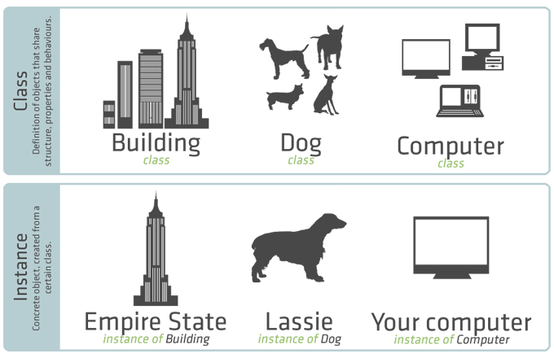
Class Versus Instance
Classes model real-world objects

Slide 34
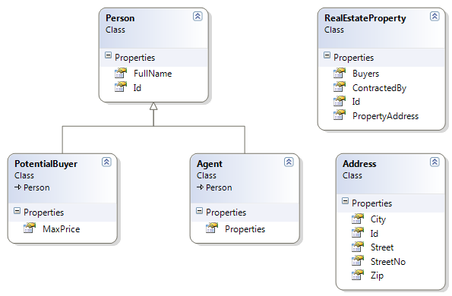
Properties
Defining and Using Data Properties

Slide 35
Properties
Properties hold the internal object state
They have visibility which should be defined at declaration
class Dog {
public $name;
public $breed;
public $age;
public $children;
}
Property declarations

Slide 36

Constructor
Defining and Using Class Constructor

Slide 37
Defining Constructor
"$this" points to the current instance of the class
class Person {
public $name;
public $age;
function __construct() {
$this->name = null;
$this->age = 0;
}
}
As a rule the constructor should initialize all class properties

Slide 38
Defining Constructor (2)
The constructor may optionally have parameters
class Person {
public $name;
public $age;
function __construct(string $name, $age) {
$this->name = $name;
$this->age = $age;
}
}
Constructor with parameters

Slide 39
Methods
Defining and Using Class Methods

Slide 40
Defining Methods
Methods are classes own functions and define behavior of the class
class Person {
public $name;
public $age;
function printNames(): void {
echo $this->name . $this->age;
}
}
Simple method with no arguments
"void" return type is available since PHP 7.1

Slide 41
Defining Methods (2)
class Person {
public $name;
public $age;
function printNames(string $name): string {
$this->name = $name;
return $this->name;
}
}
Method with parameters

Slide 42
Problem: Define a Bird Class
Create properties
age
weight
flyingSpeed
Create methods to model bird's behavior
breathe()
walk()
fly()

Slide 43
Solution: Define a Bird Class
class Bird {
private $age;
private $weight;
private $flyingSpeed;
public function __construct($age, $weight, $flyingSpeed){
$this->age = $age;
$this->weight = $weight;
$this->flyingSpeed = $flyingSpeed;
}
...
}

Slide 44
Solution: Define a Bird Class
public function walk() {
echo "Walking" . "\n";
}
public function breath() {
echo "Breathing" . "\n";
}
public function fly() {
echo "Flying" . "\n";
}

Slide 45
Anonymous Objects
More on Classes and Objects

Slide 46

Anonymous Objects
The stdClass is an empty generic PHP class for initializing objects of anonymous type (e.g. $obj = new stdClass;)
It is NOT the base class for objects in PHP
Objects can contain their own properties
e.g. $obj->prop = value;
$anonCat = new stdClass;
$anonCat->weight = 14;
echo 'My cat weighs ' . $anonCat->weight . ' kg.';
// My cat weighs 14 kg.

Slide 47
Anonymous Objects – Example
$person = new stdClass;
$person->name = 'Chinese';
$person->age = 43;
$person->weapons = ['AK-47', 'M-16', '9mm-Glock', 'Knife'];
echo json_encode($person);
// {"name":"Chinese", "age":43,"weapons":
["AK-47","M-16","9mm-Glock","Knife"]}
$obj = (object)['name' => 'Peter', 'age' => 25];
$obj->twitter = '@peter';
echo json_encode($obj);
// {"name":"Peter","age":25,"twitter":"@peter"}

Slide 48
Classes and Objects – Example
class Student {
public $name;
public $age;
public function __construct($name = null, $age = null) {
$this->name = $name;
$this->age = $age;
}
}
$peter = new Student("Peter", 21);
echo $peter->name;
$peter->age = 25;
print_r($peter); // Student Object ( [name] => Peter [age] => 25 )
$maria = new Student('Maria');
print_r($maria); // Student Object ( [name] => Peter [age] => )

Slide 49

Include and Require
Including a Script from Another Script

Slide 50
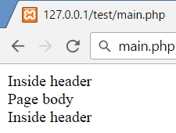

Include and Require
include and require load and evaluate a file holding PHP code
Difference between include and require:
If file is not found include produces a warning
require produces a fatal error
main.php
header.php
require "header.php";
echo "page body";
include "footer.php";
echo….
footer.php
echo….

Slide 51
include_once and require_once
With include and require you can include one file many times and each time it is evaluated
With include_once and require_once if file is already included, nothing happens
header.php
main.php
function test();
require "header.php";
echo "Page body";
include "header.php";
footer.php
function test();
Fatal error: Cannot redeclare test()…

Slide 52

Summary
…
…
…
PHP code may define and invoke functions
Functions may take arguments and return value
Functions support type hinting/declaration
Classes define specific structure for objects
Objects are particular instances of a class
Classes define properties, constructor and other members
Constructor is invoked when creating new class instances and initialize the object's internal state

Slide 54













SoftUni Diamond Partners

Slide 55





SoftUni Organizational Partners

Slide 56




Trainings @ Software University (SoftUni)
Software University – High-Quality Education and Employment Opportunities
softuni.bg
Software University Foundation
http://softuni.foundation/
Software University @ Facebook
facebook.com/SoftwareUniversity
Software University Forums
forum.softuni.bg

Slide 57

License
This course (slides, examples, demos, videos, homework, etc.) is licensed under the "Creative Commons Attribution-NonCommercial-ShareAlike 4.0 International" license

